Slide 1

MindEase
Krishang Patel

Slide 2

introducing… MindEase
Bringing Peace of Mind, One Breath at a Time
MindEase is a mindfulness and meditation app designed to help individuals reduce stress, improve mental well-being, and find inner calm through guided meditation and relaxation techniques.

Slide 3

Problem
In today's fast-paced world, stress and anxiety levels are soaring, affecting people's physical and mental health.
The need for effective stress management solutions is more critical than ever.

Slide 4
Solution:
MindEase

Slide 5

Value Proposition
Provide a happier and healthier life to the users
Stress Reduction and Mental-Well being
Personalized Experience
Accessibility Anytime, Anywhere

Slide 6

Target Market
Working Professionals
Students
Parents
Wellness Enthusiasts

Slide 7
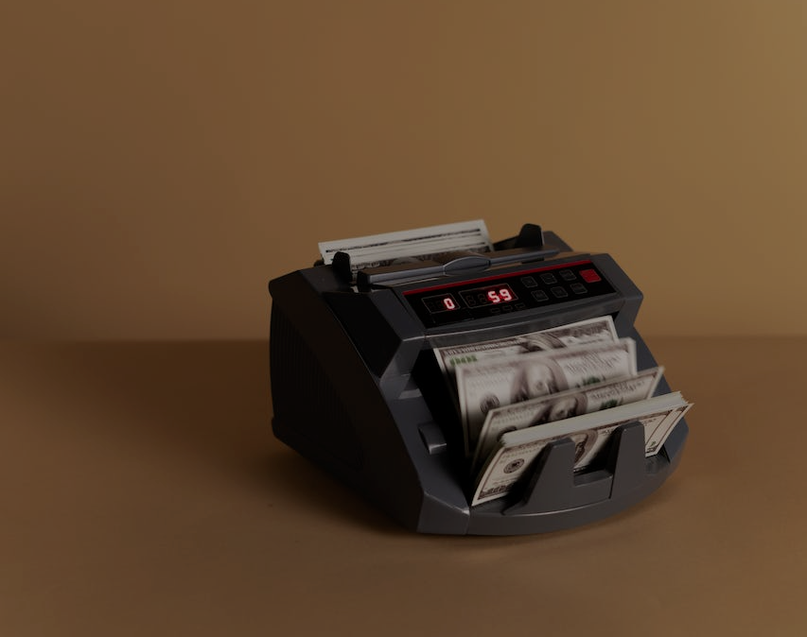
Business Models
Freemium Model
Free version of the app with basic meditation sessions and features
Premium version with advanced content, analytics, and additional features at a subscription cost
One Time Purchases
Corporate Partnerships

Slide 8
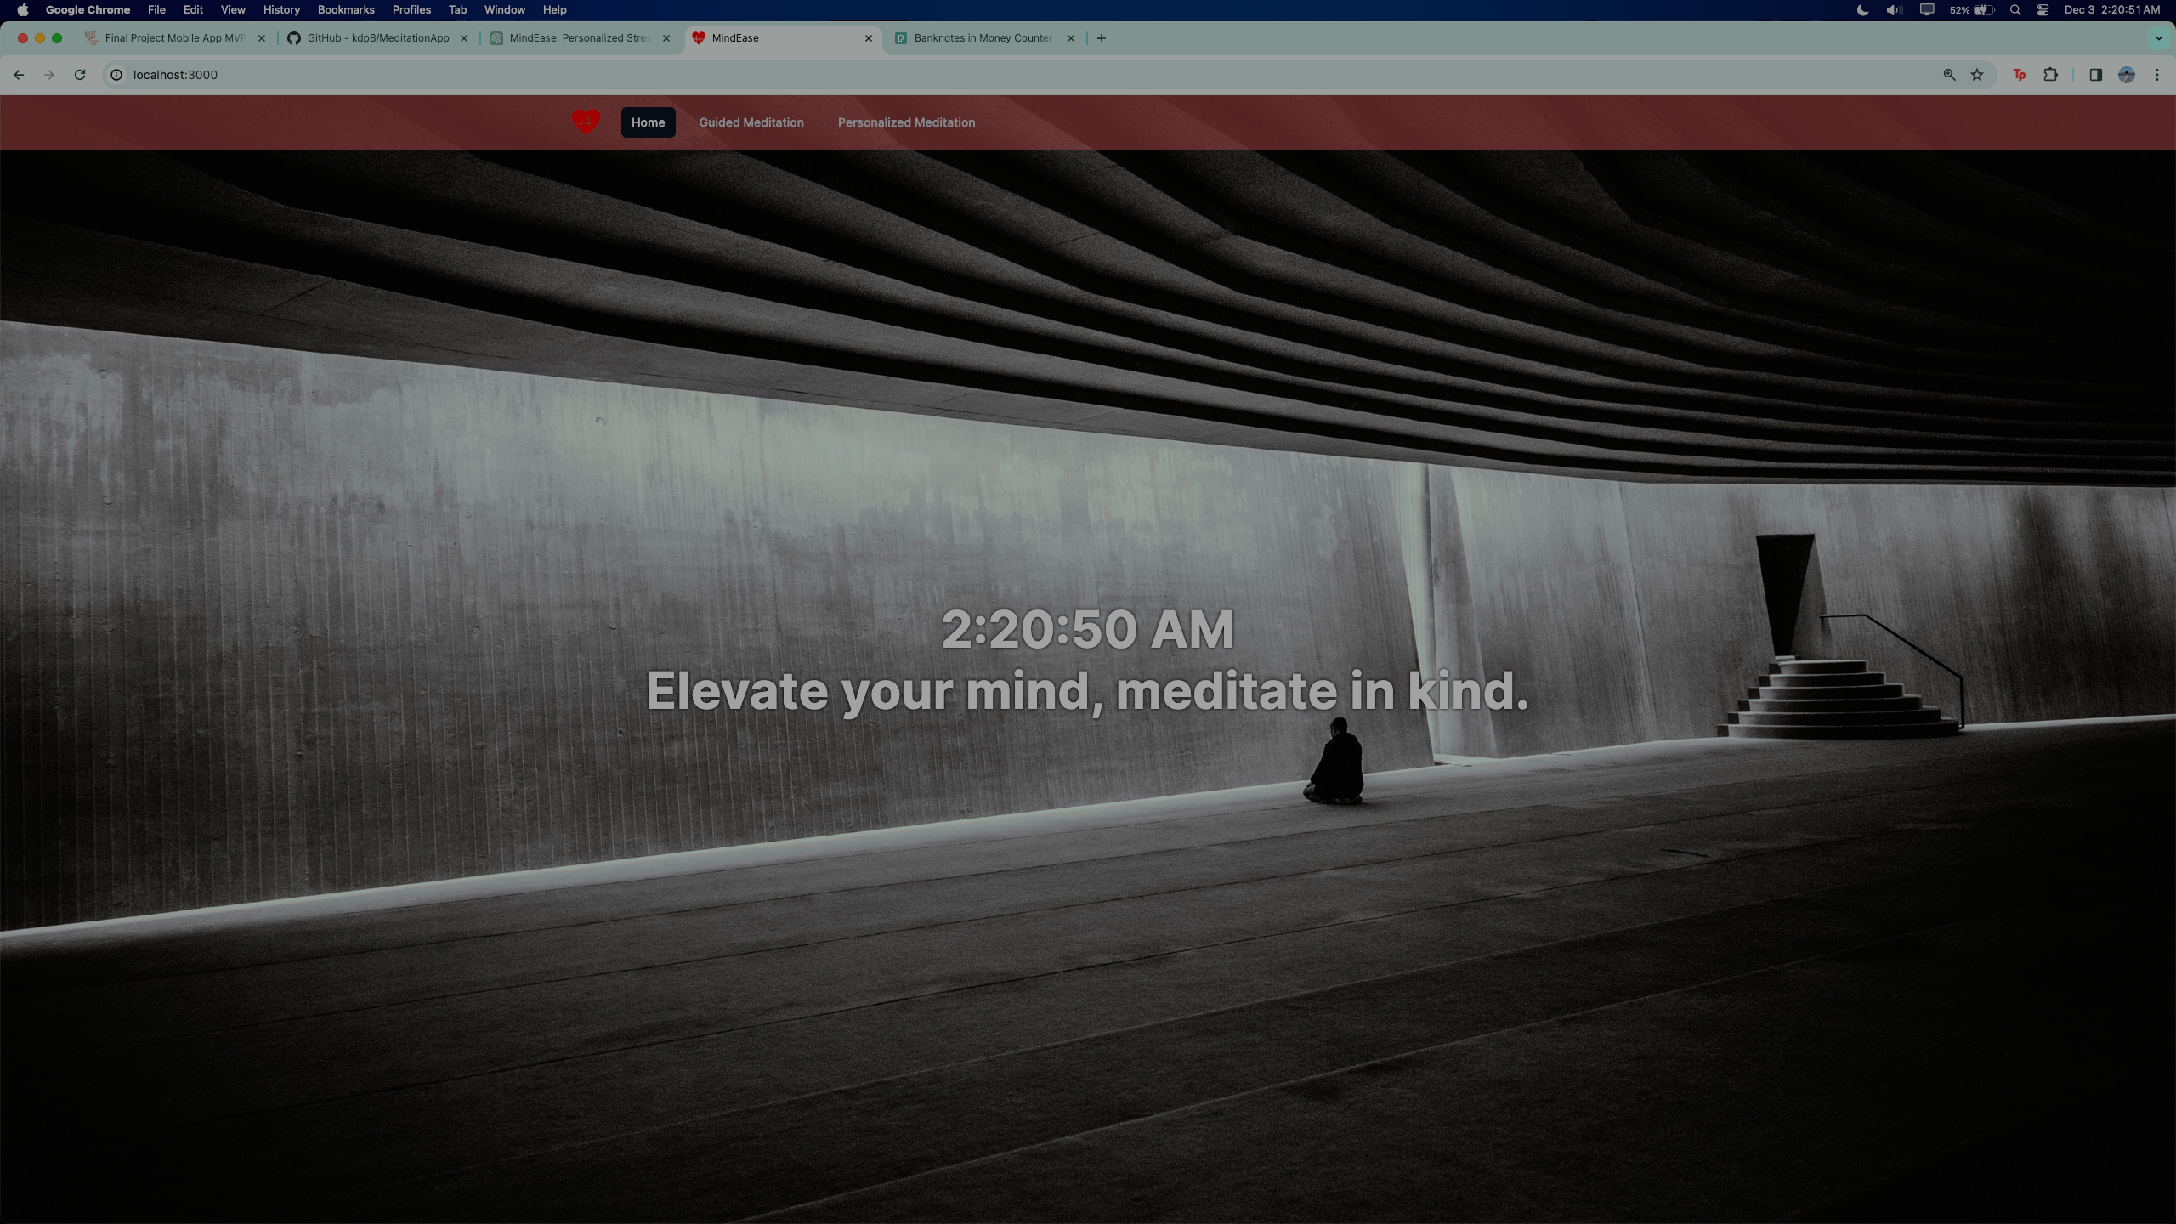
GitHub Repository: https://github.com/kdp8/MeditationApp

Slide 9

What’s next for MindEase?
Feature Expansion
Implement better AI integrations
Widen the Content (Diversify)
Enhance Personalization
User Feedbacks & Iterations

Slide 10
MindEase
Questions?

